Slide 1

PROCESS SCHEDULING SIMULATOR
V
BY
P USHASWI (192210083)
T SAI MOHITH(192211229)
S CHARAN KUMAR(192211364)

Slide 2
ABSTRACT
> The Process Scheduling Simulator is a tool designed to simulate the scheduling of processes in an operating system environment. Process scheduling is a critical component of any operating system, responsible for efficiently managing the execution of multiple processes on a single CPU. The simulator provides a platform for studying and analyzing various scheduling algorithms, enabling users to understand their behavior and performance under different scenarios.

Slide 3
INTRODUCTION
> The Process Scheduling Simulator is a software tool designed to simulate and analyze the scheduling of processes in an operating system environment. Process scheduling is a crucial aspect of operating system design, responsible for efficiently managing the execution of multiple processes on a single CPU.
> The primary goal of the Process Scheduling Simulator is to provide a platform for studying and experimenting with various process scheduling algorithms.
> By simulating the behavior of these algorithms under different scenarios, users can gain insights into their performance characteristics and make informed decisions when designing or evaluating operating systems.
> The simulator offers a user-friendly interface that allows users to define and configure multiple processes with specific attributes such as arrival time, CPU burst time, priority, and more. Users can then select from a range of scheduling algorithms to observe how these processes are scheduled and executed on the CPU.

Slide 4
HARDWARE AND SOFTWARE REQUIREMENTS
HARDWARE :
1.CPU
2.RAM
3.STORAGE
SOFTWARE:
1.OPERATING SYSTEM
2.GRAPHICAL USER INTERFACE
3.ADDITIONAL LIBRARIES

Slide 5
Existing system
> The Process Scheduling Simulator fills an important gap in the field of operating system education and research by providing a comprehensive platform for simulating and analyzing process scheduling algorithms. While there may not be an exact existing system that perfectly replicates all the features and functionalities of The Process Scheduling Simulator, there are several related tools, frameworks, and software solutions that address similar needs. Some examples include

Slide 6
Proposed system
The proposed system for The Process Scheduling Simulator aims to provide an intuitive, interactive, and comprehensive platform for simulating and analyzing process scheduling algorithms in operating systems. The proposed system will offer the following key features and functionalities:
1.User-Friendly Interface
2.Process Configuration
3.Scheduling Algorithms
4.Visualization
5.Performance Metrics
6.Experimentation and Analysis
7.Educational Resources
8.Customization and Extensibility

Slide 7
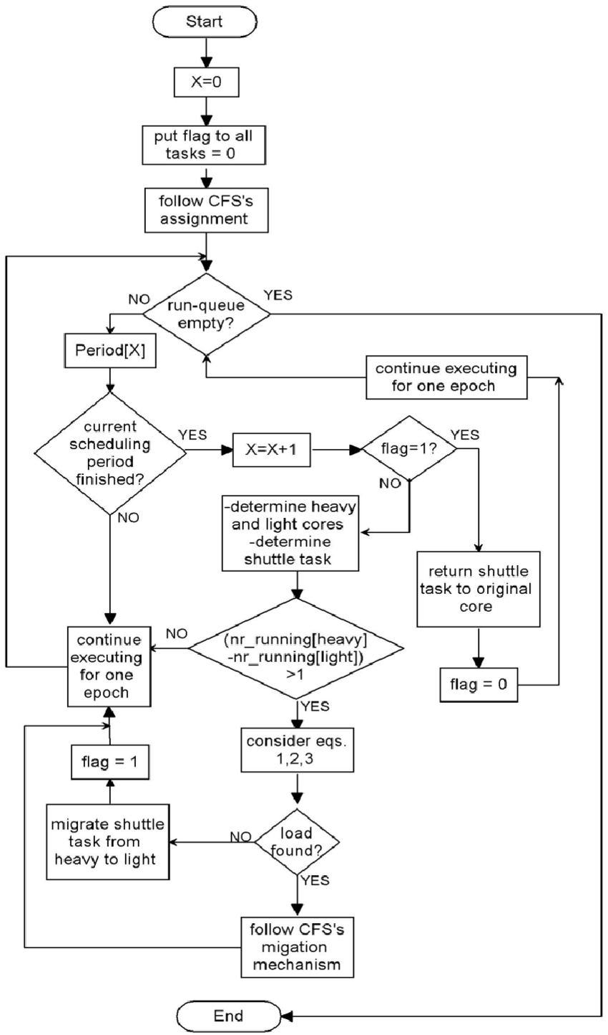
Architecture
Caption

Slide 8
Testing
Testing for The Process Scheduling Simulator is crucial to ensure its reliability, accuracy, and usability. Here are some testing strategies that can be employed:
Unit Testing: Test individual components of the simulator, such as process creation, scheduling algorithms, visualization features, and performance metrics calculation, to ensure they function correctly in isolation.
Integration Testing: Test the interaction between different components of the simulator to verify that they work together seamlessly. This includes testing how processes are scheduled, how performance metrics are calculated, and how the results are visualized.
Functional Testing: Test the simulator's functionality against expected behavior and requirements. This includes testing the ability to define and configure processes, select scheduling algorithms, visualize the scheduling process, and analyze performance metrics.
Boundary Testing: Test the simulator's behavior at the boundaries of its input ranges. This includes testing edge cases such as maximum and minimum values for process attributes, extreme values for performance metrics, and unusual scenarios that may occur during simulation.
Stress Testing: Test the simulator's performance and robustness under high load or stress conditions. This includes simulating a large number of processes, using complex scheduling algorithms, and running multiple simulations
concurrently to assess the simulator's scalability and stability.

Slide 9
Implementation
>TASK SCHEDULING BASED ON PRIORITY LEVELS FOR REAL-TIME RESPONSE.
>Efficient management of resources such as CPU, memory, and I/O devices.
>Support for multimedia data streams with time constraints.
>Implementation of synchronized communication protocols for multimedia data transmission. Integration of real-time networking protocols to ensure timely delivery of data packets.
>Utilization of specialized algorithms for buffering and data processing to meet strict timing requirements.
>Monitoring and management of system parameters to guarantee continuous operation within real- time constraints.
Implementation of fault tolerance mechanisms to handle system failures without compromising real-time performance.

Slide 10
Final output

Slide 11
Conclusion
By implementing a process scheduling processor, operating systems can achieve better resource utilization, improved system responsiveness, and enhanced overall performance. The scheduler plays a key role in ensuring fairness, efficiency, and responsiveness in multitasking environments by determining the order in which processes are executed and allocating CPU time accordingly.
Furthermore, a well-designed and implemented process scheduling processor contributes to the stability, reliability, and usability of the operating system. It allows users to run multiple concurrent processes smoothly and efficiently, providing a seamless computing experience.
Overall, the implementation of a process scheduling processor requires careful planning, attention to detail, and thorough testing to ensure its effectiveness, reliability, and performance. With the proper design and implementation, a process scheduling processor can significantly enhance the capabilities and performance of an operating system, enabling it to meet the demands of modern computing environments.

Slide 12
Future scope
The future scope for a Process Scheduling Simulator is broad and encompasses various areas of improvement and expansion. Some potential avenues for future development and enhancement include:
Additional Scheduling Algorithms: Incorporate support for more advanced and specialized process scheduling algorithms, such as Multilevel Feedback Queue (MLFQ), Lottery Scheduling, Earliest Deadline First (EDF), and Rate Monotonic Scheduling (RMS). This would allow users to explore a wider range of scheduling policies and compare their performance.
Real-time Scheduling: Extend the simulator to support real-time process scheduling, enabling users to simulate and analyze the behavior of real-time operating systems and scheduling algorithms. This could include support for fixed-priority scheduling, deadline-based scheduling, and priority inheritance mechanisms.
Visualization Enhancements: Enhance the visualization features of the simulator to provide more interactive and informative graphical representations of the scheduling process. This could include animated simulations, interactive timelines, and customizable charts to visualize scheduling decisions and performance metrics.
Multi-core Scheduling: Extend the simulator to support multi-core processors and parallel execution of processes. This would involve simulating the scheduling of processes across multiple CPU cores and analyzing the performance of different scheduling algorithms in a multi-core environment.

Slide 13
Literature survey
A literature survey for a Process Scheduling Simulator would involve reviewing existing research papers, academic publications, books, and online resources related to process scheduling algorithms, simulation techniques, and operating system design. Here is an overview of potential sources and topics to consider in a literature survey:
Research Papers and Academic Publications:
>Review papers that discuss various process scheduling algorithms, such as FCFS, SJF, RR, Priority Scheduling, MLFQ, etc.
>Look for papers that propose novel scheduling algorithms, optimization techniques, or performance analysis methods.
>Explore papers that compare and evaluate the performance of different scheduling algorithms under various conditions and workloads.
>Identify papers that discuss real-time scheduling, multi-core scheduling, and scheduling in distributed systems.
Consult textbooks on operating system concepts and principles, such as "Operating System Concepts" by Abraham Silberschatz, Peter Baer Galvin, and Greg Gagne.
Look for books that specifically cover process scheduling algorithms and techniques, such as "Modern Operating Systems" by Andrew S. Tanenbaum and Herbert Bos.

Slide 14
Reference
GeeksforGeeks (https://www.geeksforgeeks.org/) - GeeksforGeeks offers articles, tutorials, and implementation examples on various topics related to computer science, including process scheduling algorithms.
Tutorialspoint (https://www.tutorialspoint.com/) - Tutorialspoint provides tutorials and resources on a wide range of topics, including operating systems and process scheduling.
GitHub (https://github.com/) - GitHub hosts numerous open-source projects related to process scheduling simulation and implementation. You can find sample code, projects, and repositories to explore and learn from.

Slide 15

Caption

